Slide 1
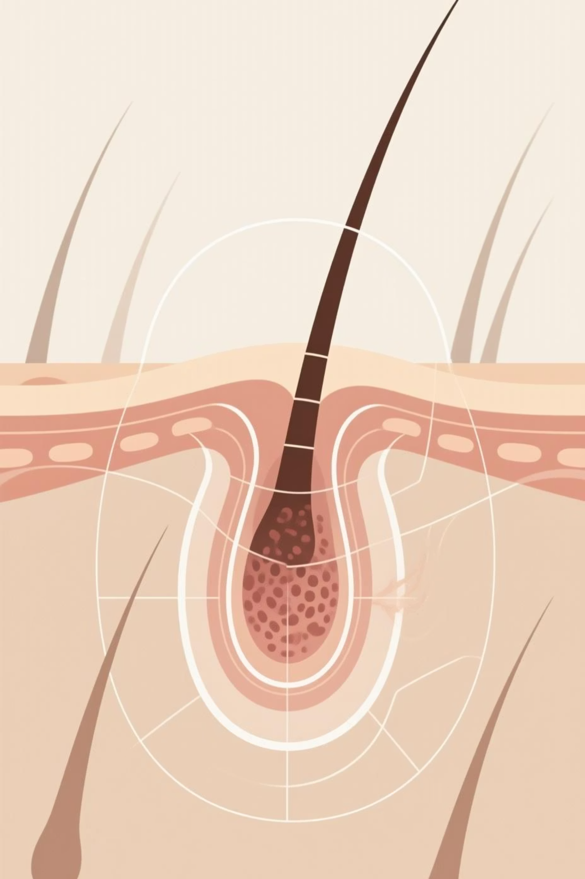
Automated Skin Lesion Segmentation for Melanoma Detection
Using DeepLabV3+ and CRISP-DM Methodology
Authors: Soham Raj Jain, Prachi Gupta, Shilpa Yelkur Ramakrishnaiah and Abhishek Darji

Slide 2


Why Automated Melanoma Detection Matters
Melanoma, the most dangerous form of skin cancer, necessitates early detection for life-saving interventions. Manual analysis of dermoscopic images is time-consuming, subjective, and demands specialised expertise, which is often scarce in underserved areas.
Early Detection
Late Detection
99% Survival Rate
27% Survival Rate
Our AI-powered system aims to accurately segment skin lesions, thereby assisting doctors in faster and more accurate diagnoses, bridging the healthcare accessibility gap.

Slide 3
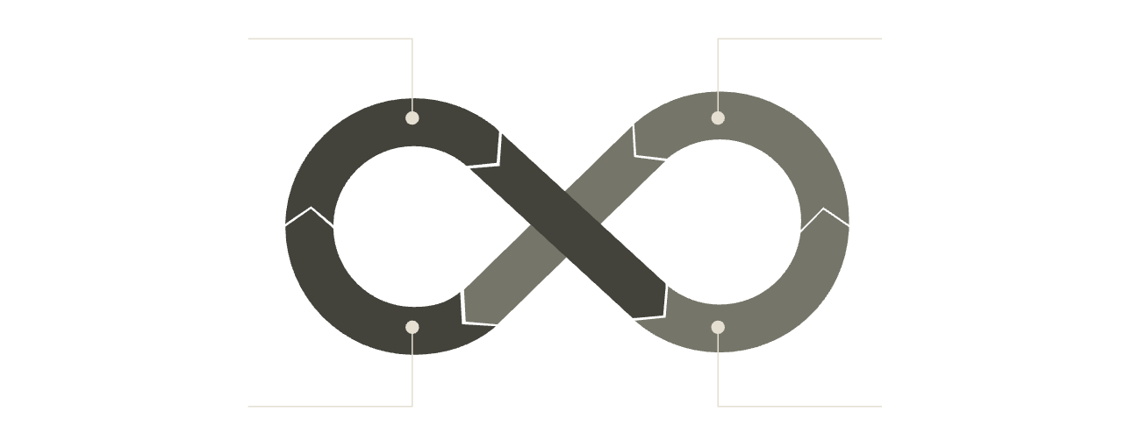
Objectives and Approach
Our primary goals for this project are to achieve clinically relevant segmentation accuracy, ensuring reliability for lesion analysis.
1
Achieve Dice Coefficient > 0.89
Business Understanding
Data Understanding
A measure of spatial overlap between the predicted and ground truth segmentation.
Modeling
Data Preparation
2
Achieve Intersection over Union (IoU) > 0.83
Quantifies the overlap between detected and actual lesion areas.
We rigorously followed the industry-standard CRISP-DM framework, ensuring a structured and comprehensive approach to model development and evaluation.

Slide 4
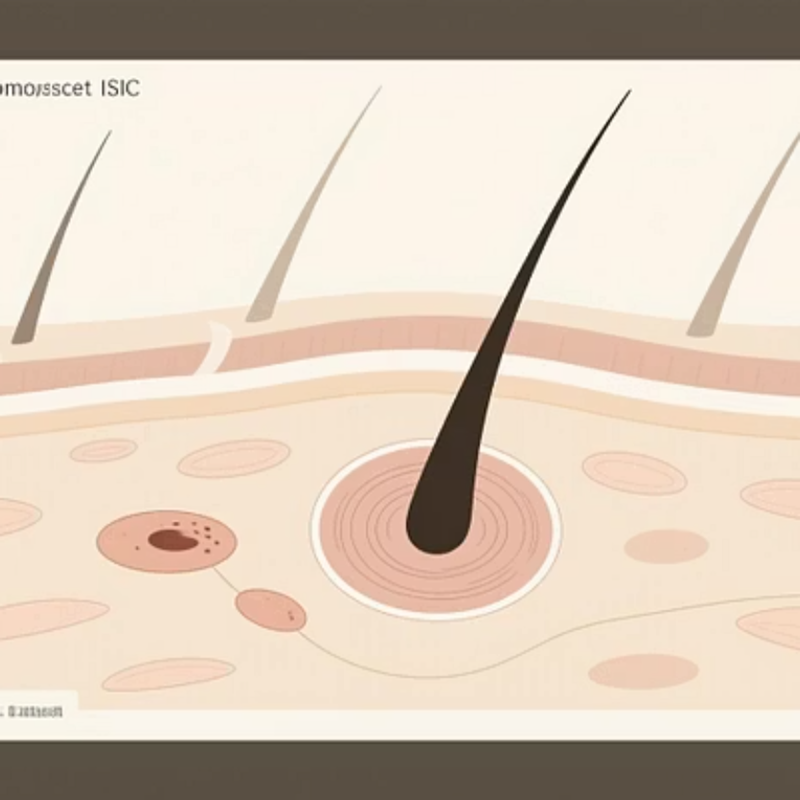
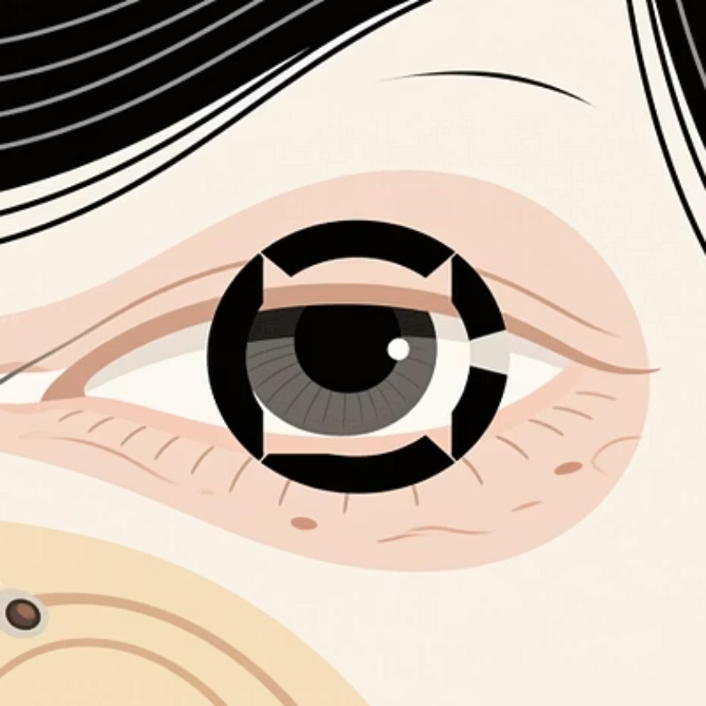
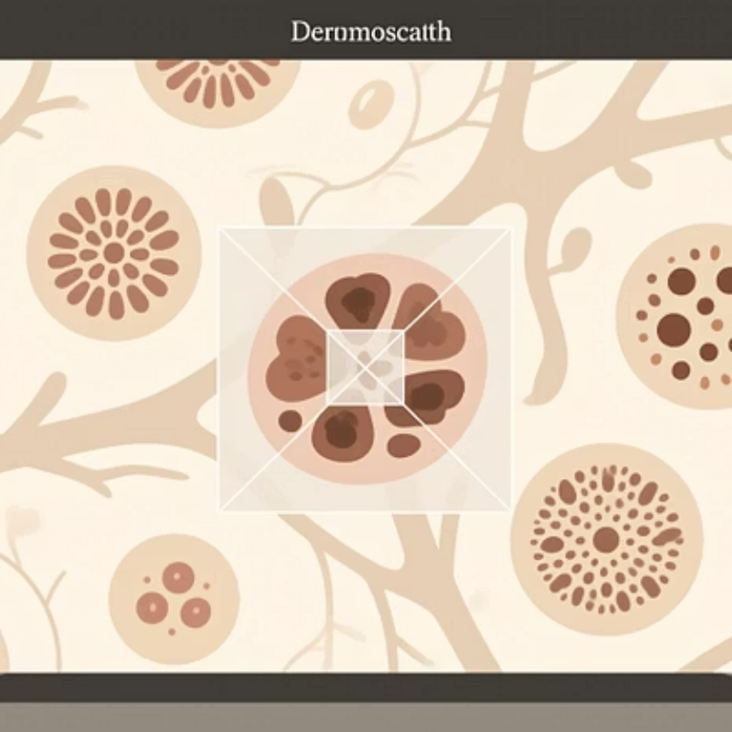
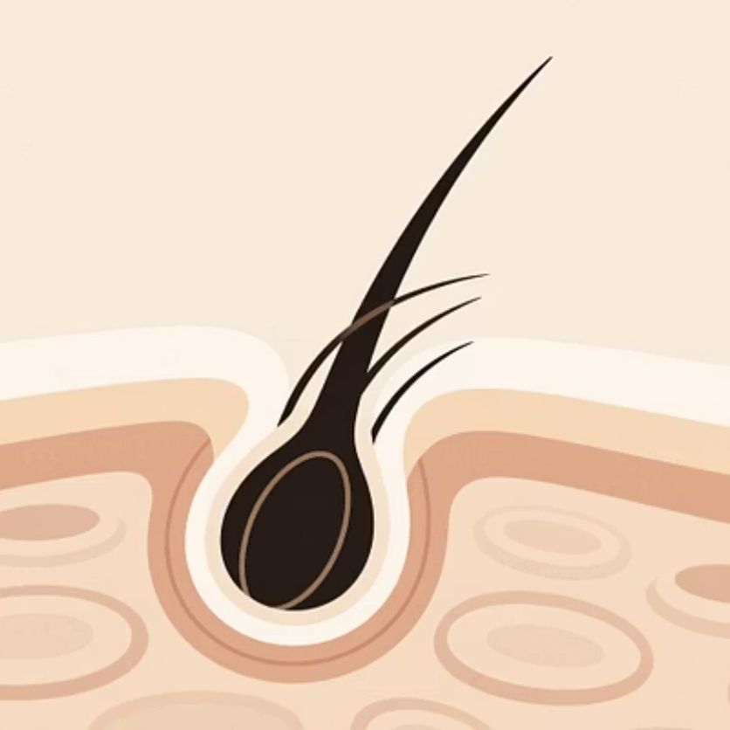
ISIC 2018 Challenge Dataset: An Overview
Dataset Specifications
Key Characteristics & Challenges
Source: International Skin Imaging Collaboration (ISIC) Archive
Mean Lesion Area: 21.40% of image (Median: 13.81%)
Total Training Images: 2,594 dermoscopic images
Lesion Size Range: 0.30% to 98.66%
Format: RGB images with binary segmentation masks
206 unique image dimension combinations
Image Dimensions: Highly variable (566×679 to 4420×6640 pixels)
Challenges: Right-skewed distribution, variable quality, artifacts (hair, rulers, frames)

Slide 5
Exploring the Data Landscape: Insights from ISIC 2018
Our comprehensive data understanding revealed a right-skewed lesion area distribution, with most lesions occupying 5-35% of the image area, indicating significant variability and a standard deviation of 20.83%.
Large Irregular Lesions
Small Focal Lesions
Variable Lighting & Tone
Diverse Skin Textures
Example showcasing 34.59% lesion coverage with complex morphology.
Illustrating a smaller lesion covering 13.63% of the image, critical for early detection.
Highlighting images with varied skin textures and surrounding anatomical features.
Sample demonstrating challenges posed by inconsistent lighting and diverse skin pigmentation.
The dataset's strengths include expert-annotated masks and diverse lesion types, though challenges like class imbalance and imaging artifacts were noted.

Slide 6

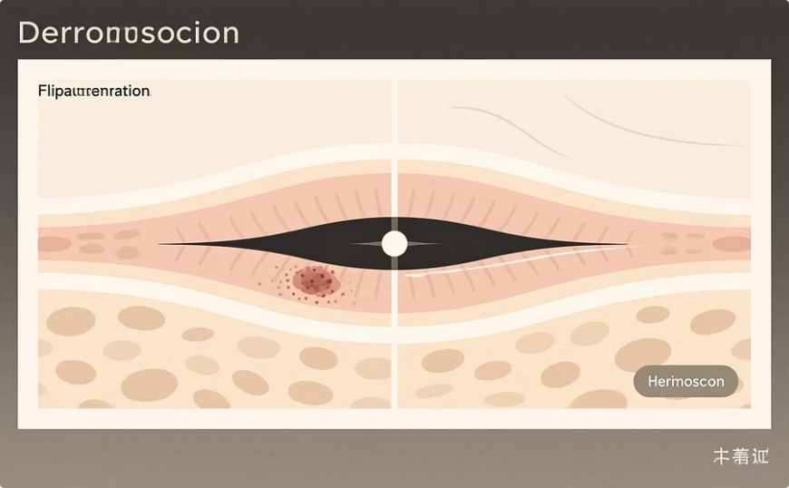
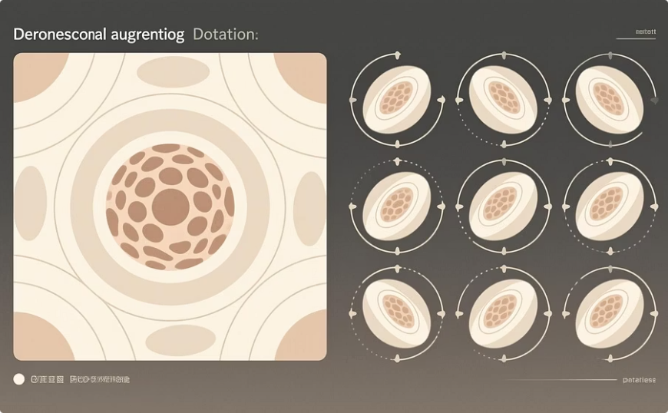
Data Preparation Pipeline: Optimising for Performance
Our rigorous preprocessing pipeline ensures that the data is optimised for model training, simulating real-world variations and enhancing robustness.
Standardisation
Resized all images to 512×512 pixels.
Normalised using ImageNet statistics.
Binary thresholding on masks (threshold=127).
Data Splitting
Training: 2,075 images (80%)
Validation: 260 images (10%)
Test: 259 images (10%)
Extensive augmentation techniques, including geometric and colour adjustments, were applied to improve model generalisation and address class
imbalance.
Horizontal Flip
Rotation

Slide 7
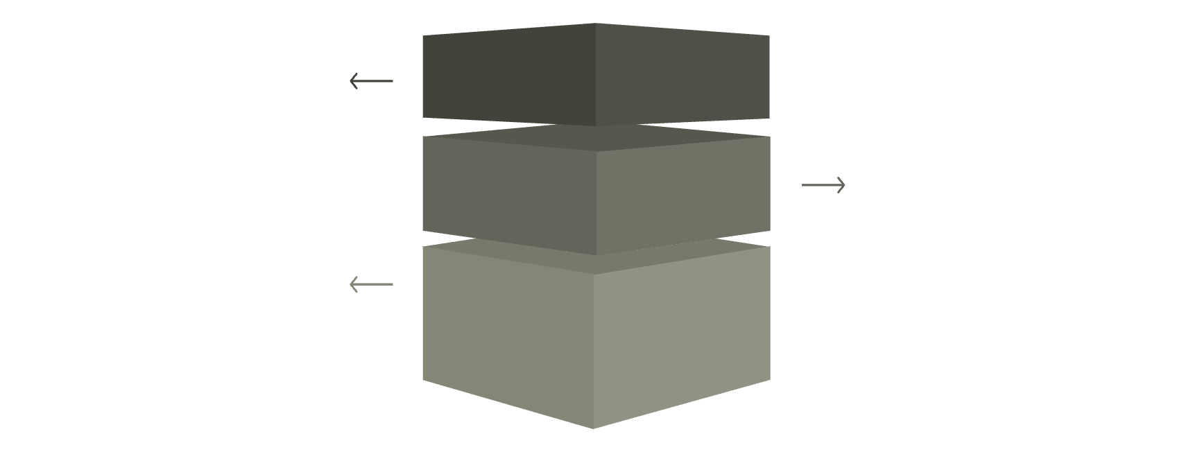
DeepLabV3+: State-of-the-Art Segmentation Model
DeepLabV3+ was chosen for its superior performance in medical imaging, offering multi-scale contextual understanding vital for accurate lesion segmentation.
Encoder (ResNet-50)
Pre-trained backbone with atrous convolutions.
ASPP Module
Parallel atrous convs and global average pooling.
Decoder Module
Depthwise separable convs with progressive upsampling.
Encoder (ResNet-50)
ASPP Module
Decoder Module
Pre-trained on ImageNet for robust feature extraction.
Captures multi-scale information using parallel atrous convolutions (rates: 6, 12, 18).
Fuses high-level semantic information with low-level spatial details.
Utilises modified atrous convolutions to maintain spatial resolution.
Incorporates global average pooling for comprehensive context.
Employs depthwise separable convolutions and progressive upsampling to 512×512 output.
Model Statistics: The DeepLabV3+ architecture boasts 41.26 million parameters, balancing complexity with performance.

Slide 8
Optimising for Clinical Performance: Training Strategy
Our training strategy employed a combined loss function to achieve optimal clinical performance, addressing both spatial overlap and class imbalance.
Combined Loss Function
Optimizer
Total Loss = 0.7 × Dice Loss + 0.3 × Focal Loss
AdamW with weight decay (0.0001)
Dice Loss: Directly optimises for segmentation overlap, aligning with our primary evaluation metric.
Focal Loss: Effectively handles extreme class imbalance by down-weighting well-classified examples, focusing on hard cases.
Learning Rate
0.001 with OneCycleLR scheduler
Training was conducted on NVIDIA Tesla T4/V100 GPUs, completing within 2-3 hours, with early stopping preventing overfitting and ensuring model generalisation.
Batch Size
12

Slide 9
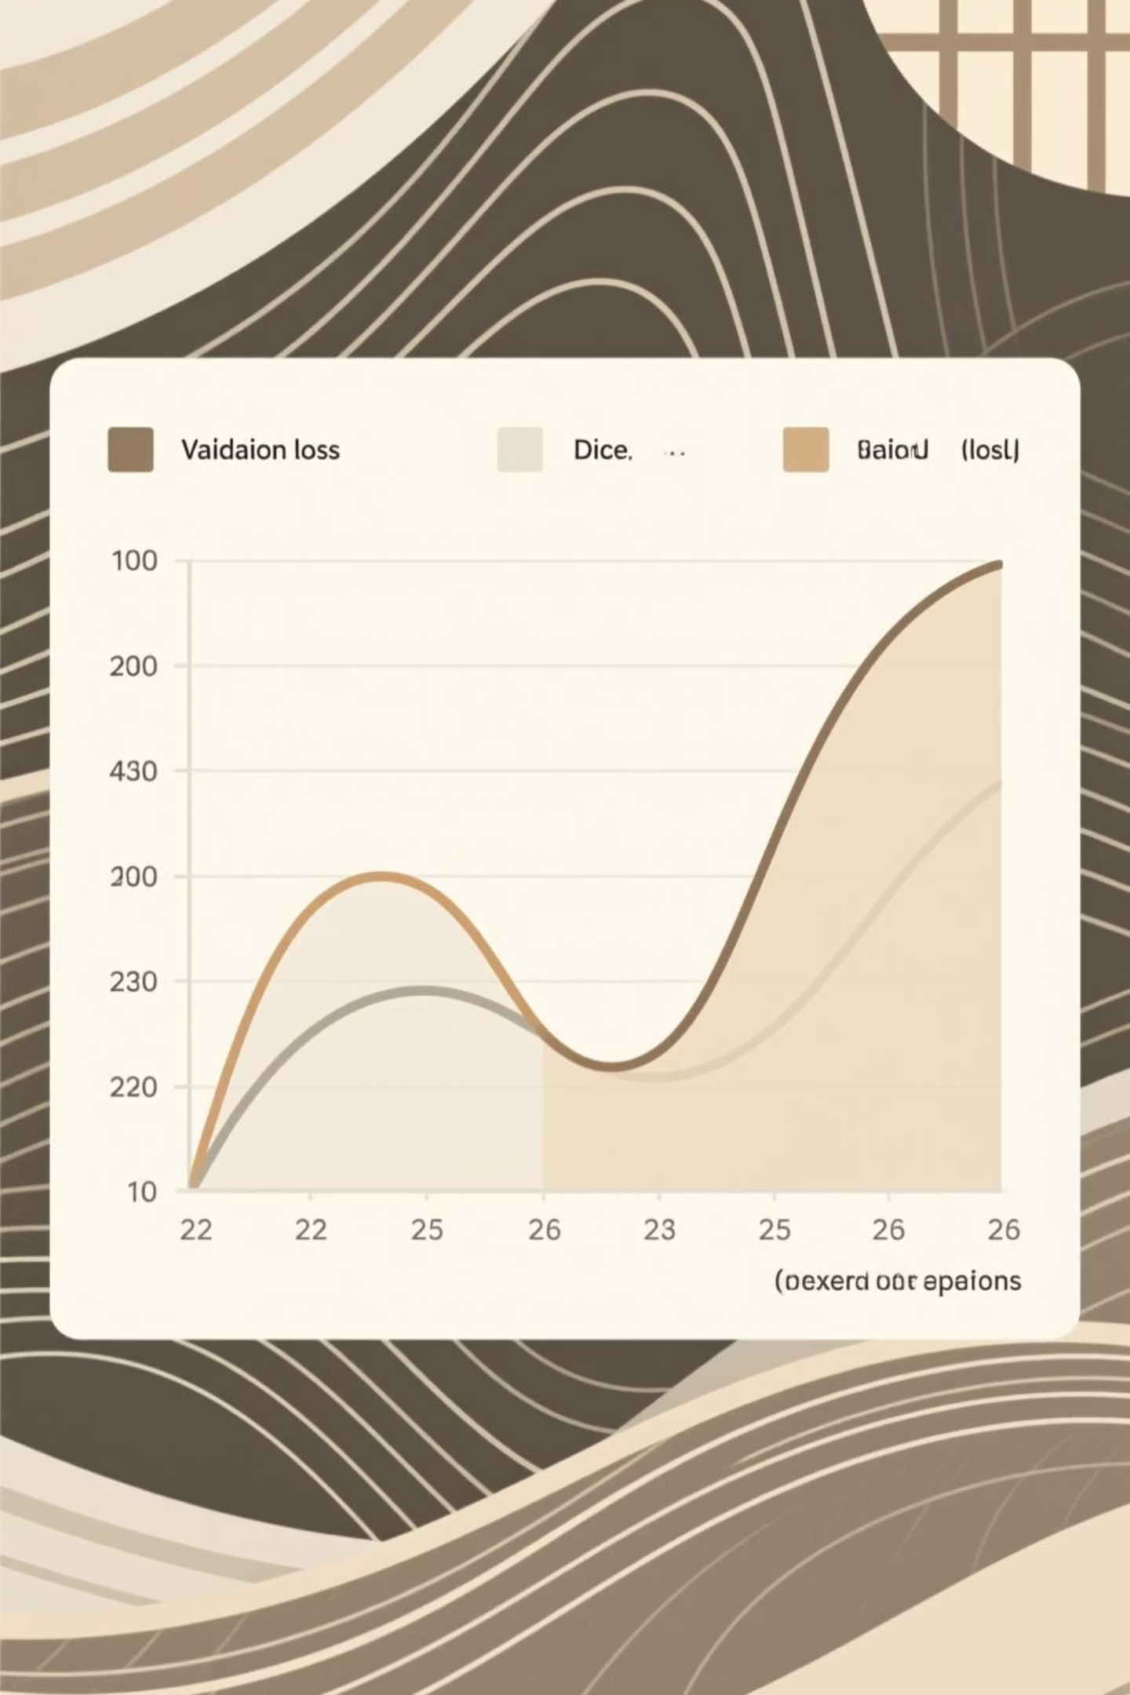
Achieving Target Performance: Training Convergence
Our model demonstrated stable and consistent convergence, rapidly surpassing target metrics for both Dice Coefficient and IoU.
Training Journey
Key Milestones
Initial performance (Epoch 1): Dice: 0.78, IoU: 0.64
Dice target (>0.89) crossed at epoch 8
Final performance (Epoch 23): Dice: 0.921, IoU: 0.855 on validation
IoU target (>0.83) crossed at epoch 10
Stable convergence with excellent generalisation, minimal overfitting.
The early stopping mechanism successfully prevented overtraining, leading to a robust model capable of generalising to unseen data effectively.

Slide 10
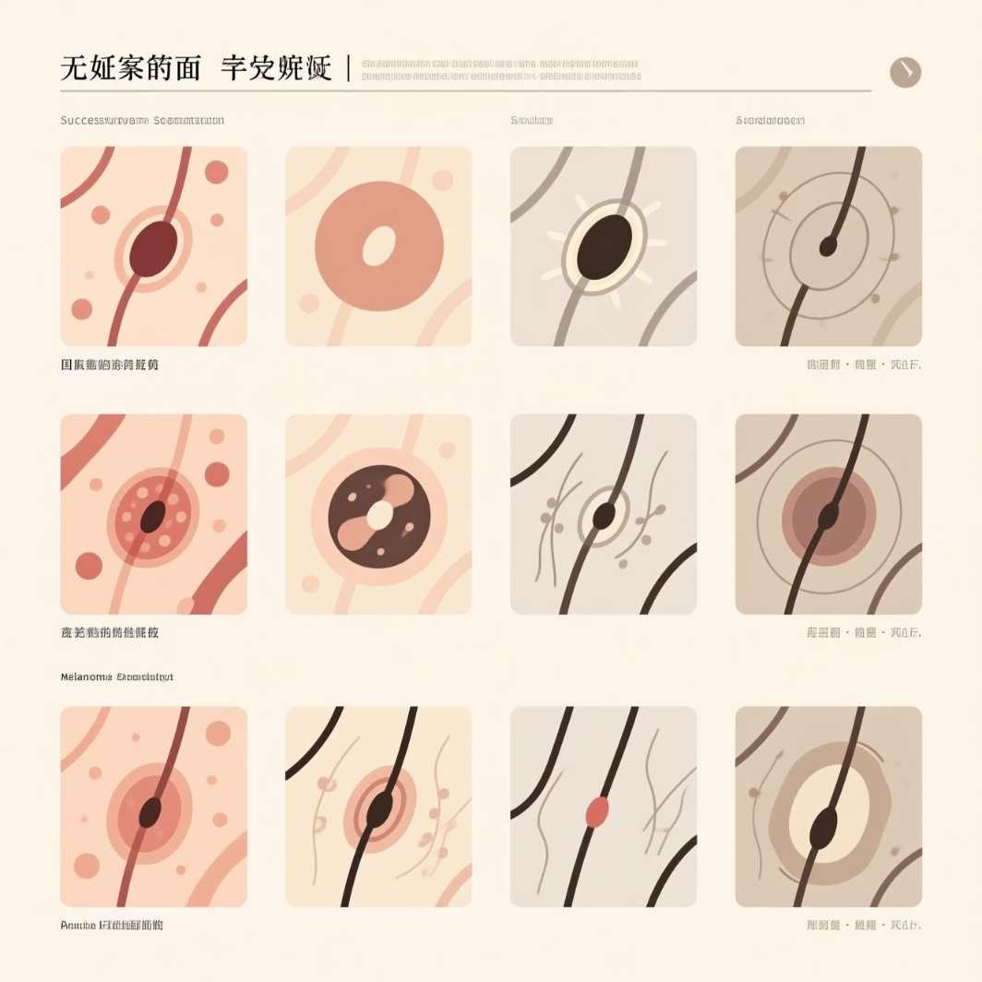
Clinical-Grade Performance Achieved: Final Results & Impact
Our DeepLabV3+ model exhibits strong performance on the test set, indicating its readiness for clinical assistance in melanoma detection.
0.8907
0.8206
88.84%
97.36%
Dice Coefficient
IoU
Sensitivity
Specificity
Target met: >0.89
98.8% of target: >0.83
Ability to correctly identify positive cases.
Ability to correctly identify negative cases.
Key Achievements
Excellent lesion boundary delineation.
High specificity, minimising false positives.
Robust across diverse lesion sizes (0.3% - 98% of image) and skin conditions.
This model can significantly assist dermatologists in achieving faster, more accurate diagnoses, potentially saving lives through early melanoma detection.
Future Work
Explore ensemble methods to further enhance accuracy.
Extended training to push IoU target.
Develop advanced artifact removal techniques.

Slide 11
Thank You
Advancing Skin Cancer Detection with AI
We appreciate your time and attention to our presentation on the DeepLabV3+ model for melanoma detection.

